Slide 1




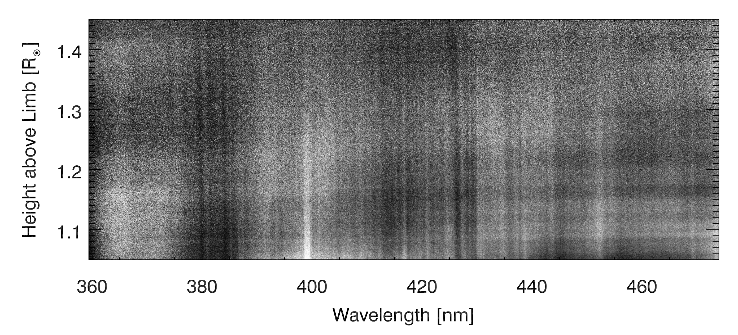
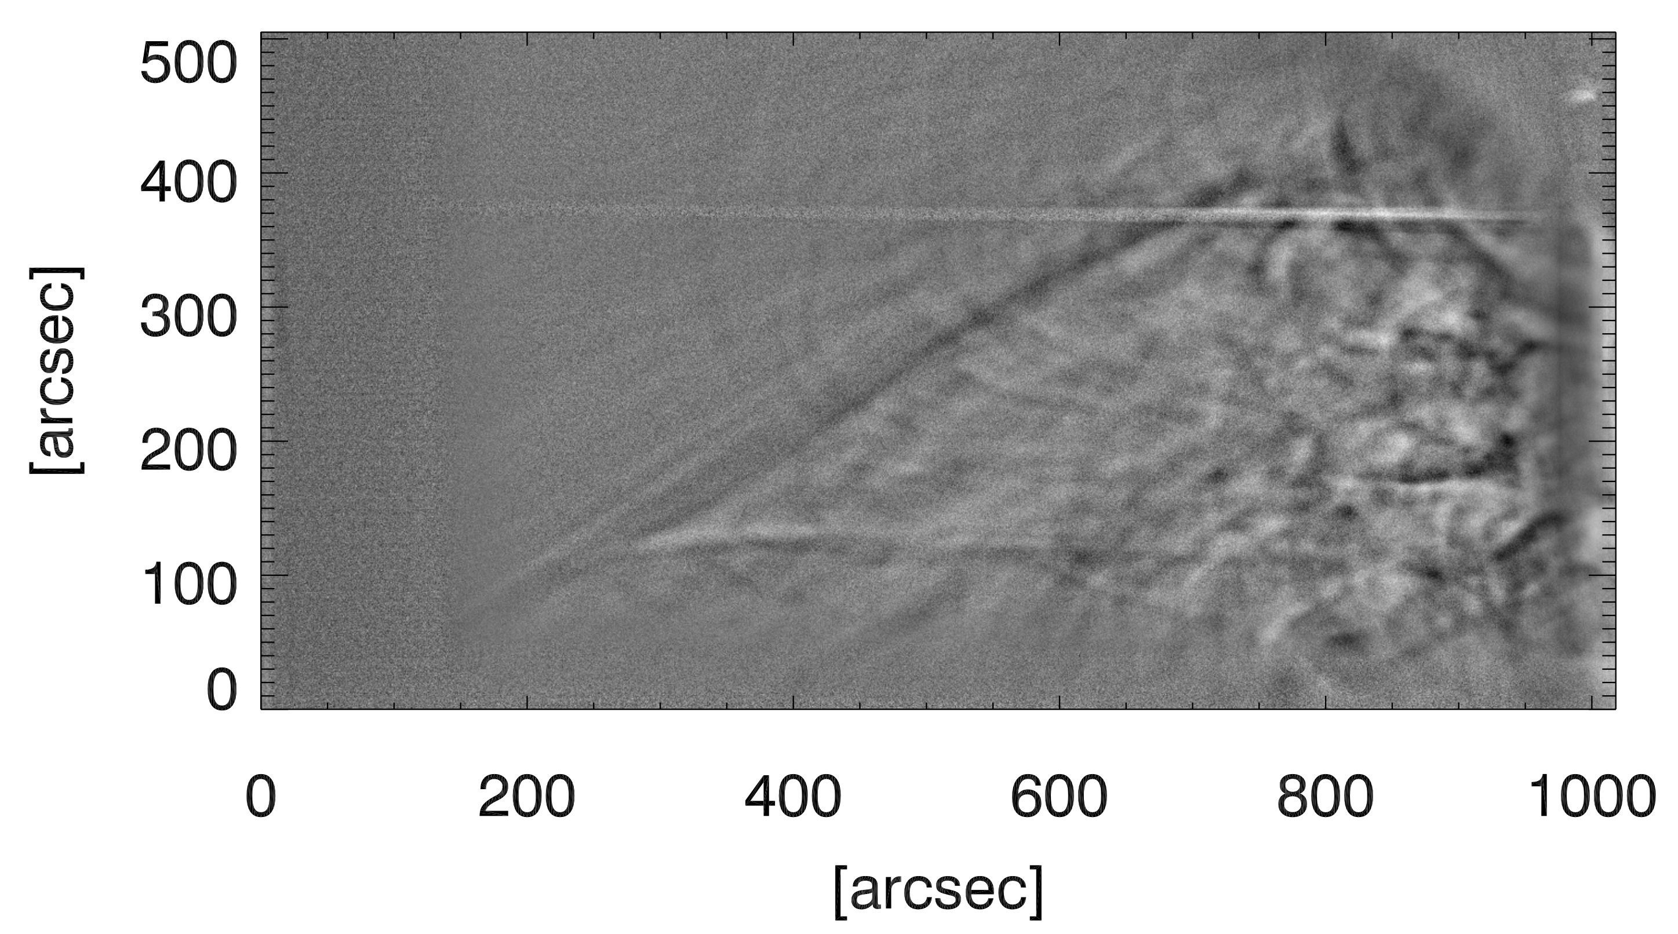
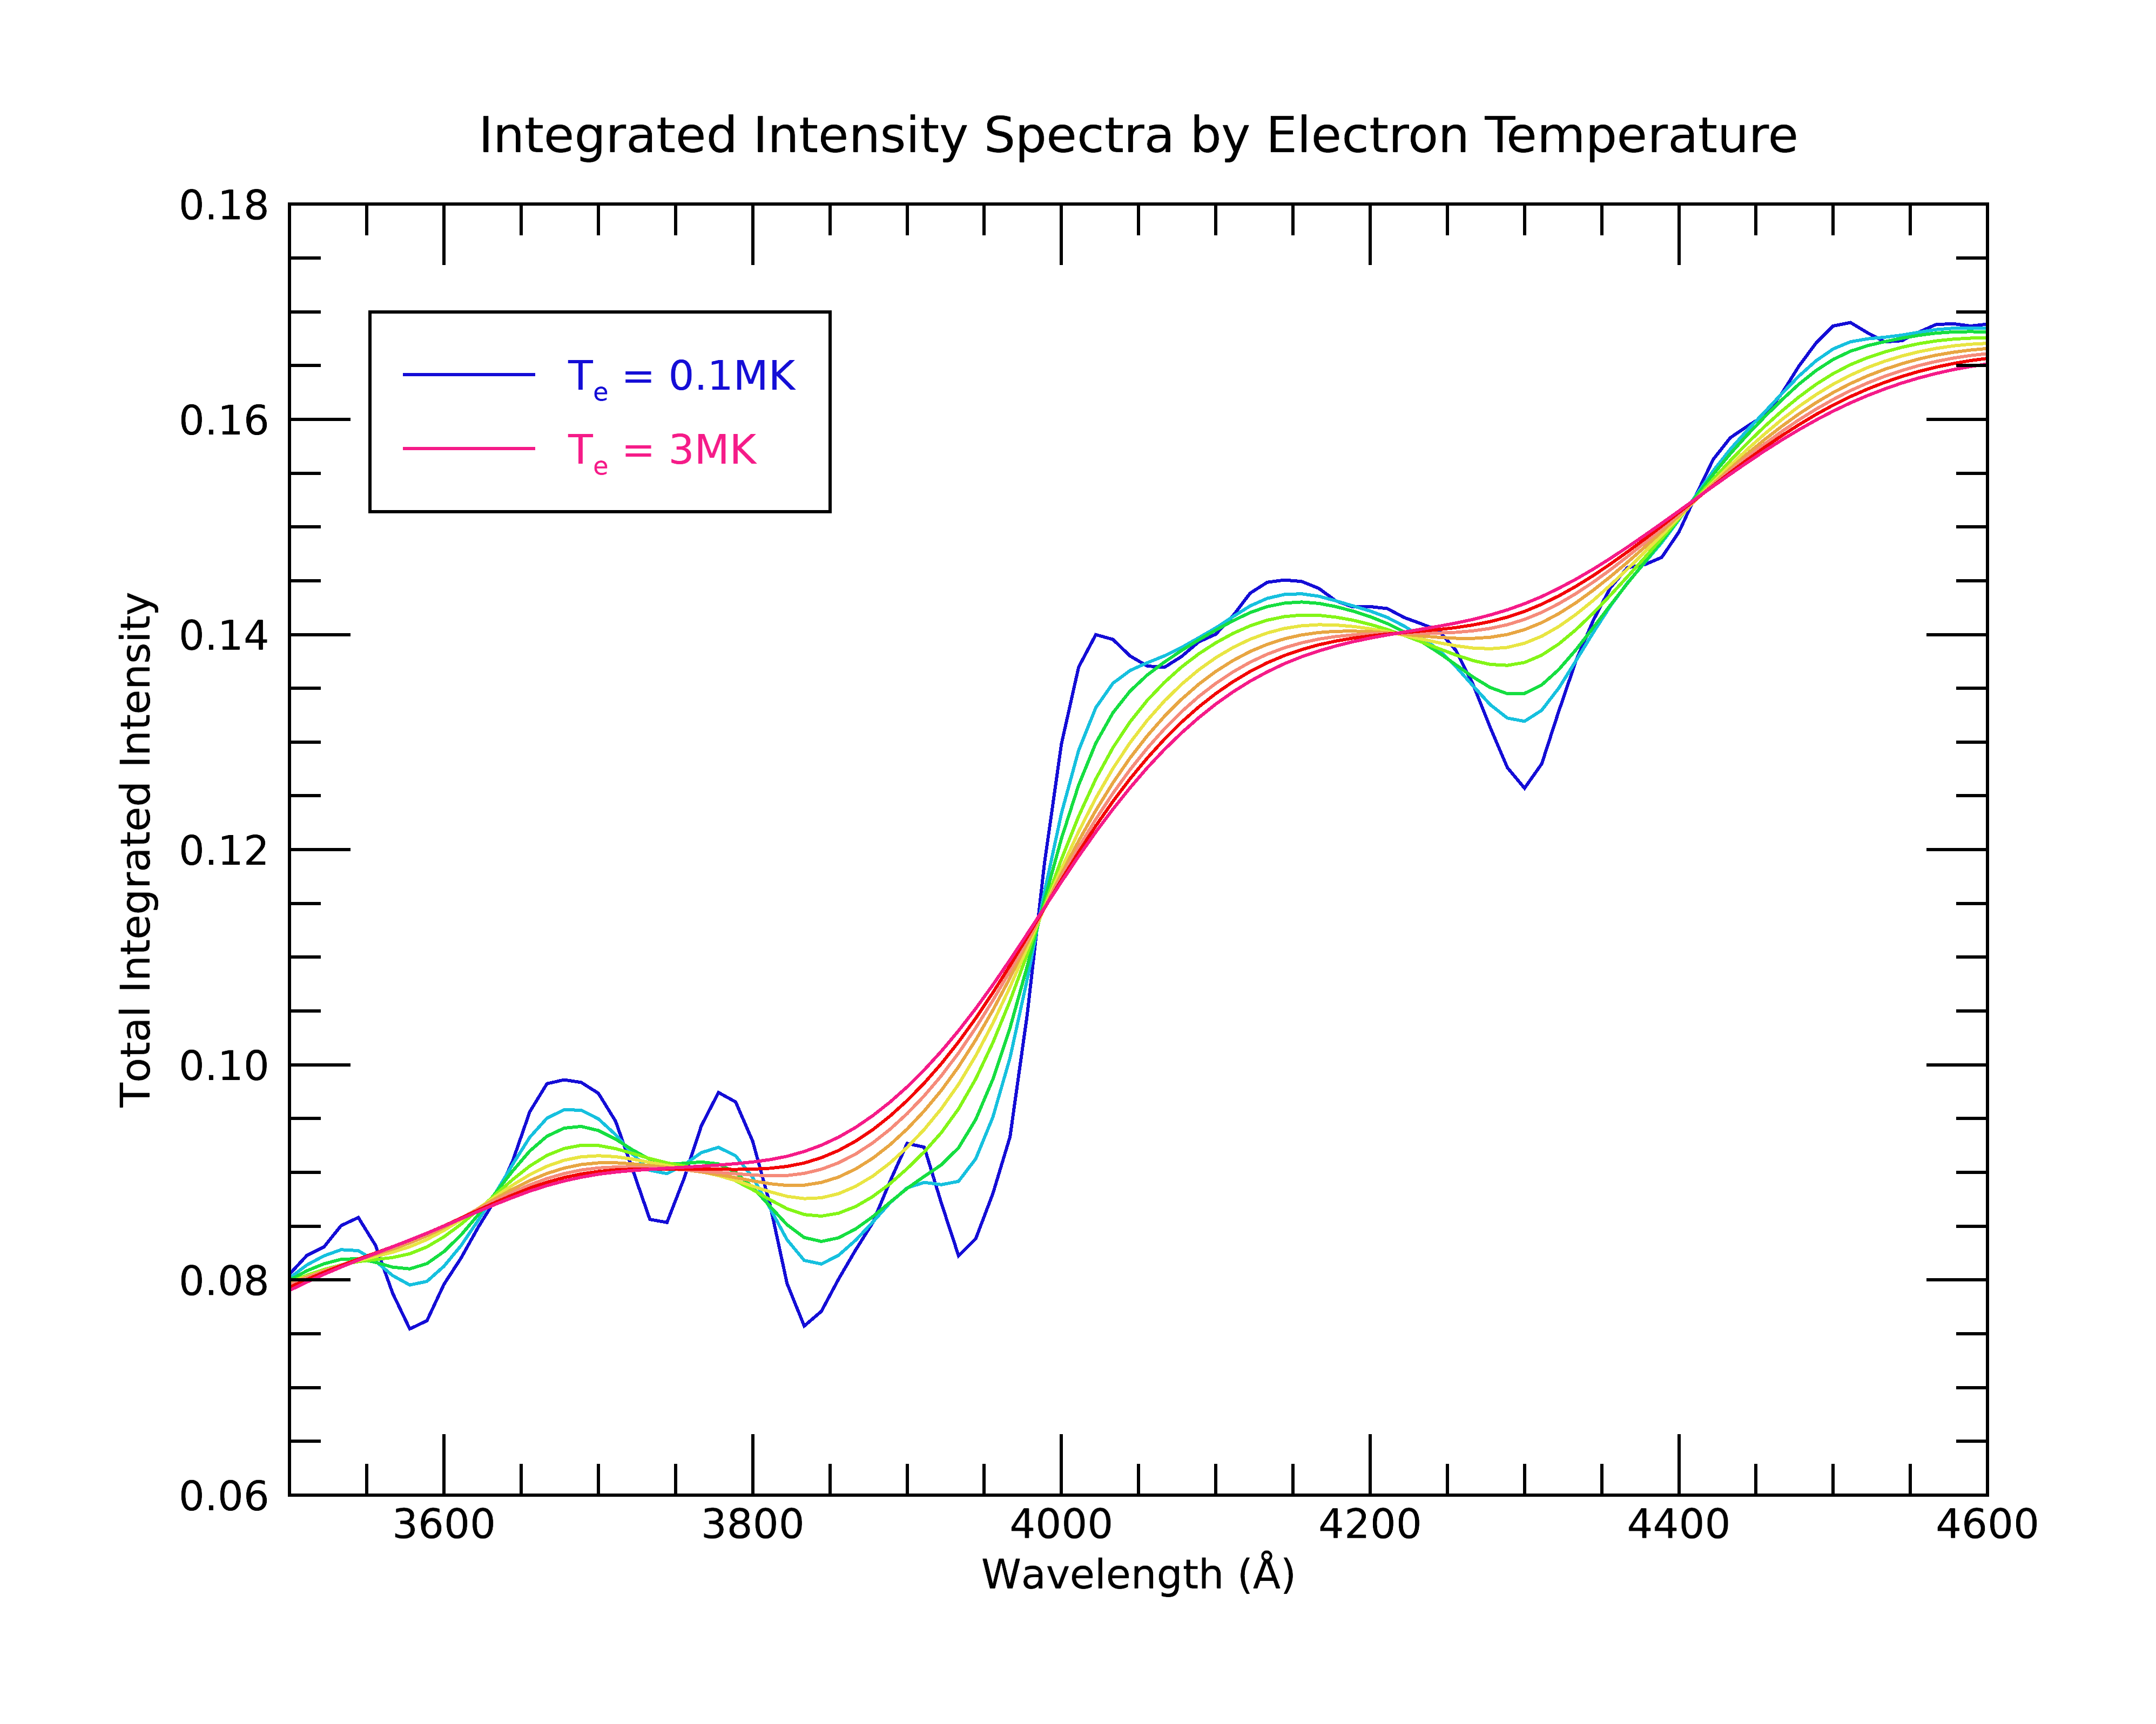
K-Corona Measurements at the 20 April 2023
Solar Eclipse
Sarah Bruce^{1,2}, Kevin Reardon^{1,2} ¹Department of Astrophysical and Planetary Sciences, University of Colorado Boulder, ²National Solar Observatory
Introduction
Spectra
Conclusion
During the 52-second total solar eclipse of 20 April, 2023 in Exmouth, Australia, we carried out several experiments aiming at investigating the low solar corona. We used a low dispersion (0.28 Å/pixel) slit spectrograph to obtain spectra covering the interval from 3600-4700 Å between 1-1.5 R☉). The scattering of the photospheric emission by the high-temperature, high-velocity coronal electrons smears out any Fraunhoffer lines but leaves broad spectral signatures that can be used to infer the magnitude of the broadening and hence the coronal electron temperature (Cram, 1976). Such measurements have been carried out a few times in the past (e.g. Ichimoto, et al., 1996; Reginald, 2009) and are the basis of the upcoming CODEX mission.
figures
Figures
Results
Ga. Oviduntusam exerum fugitat quae el exersperum qui corum sam sitas que officiat am el inust dunt mint ut vel il mintis es vel maxim dolupiet, aut quatur aborem quiae explitatur sum venihit quo con cusda volorum quia qui conessunt vel etur? Quis nullitae porunto mod maiorio ex es dolupis eum solupta spellande moluptionem consequae volum audanto tatiae
figures
K-Coronal Temperatures
Vitam voloria con et, cum laboreium, nam cum, quat paris as core volorest, sust exceatur antio ea voluptas eumquatendit quas doluptatet aut landignam que lantur sania dem escidit min reruptiaero velis maximus aut que pe aliquas sequidisit, omnient hit lam eicias modio con nisin pediam, ent, cust accaborit odio corehen dendae nonet eliquam, aperorepe autatem
figures
figures
References
Ga. Oviduntusam exerum fugitat quae el exersperum qui corum sam sitas que officiat am el inust dunt mint ut vel il mintis es vel maxim dolupiet, aut quatur aborem quiae explitatur sum venihit quo con cusda volorum quia qui conessunt vel etur? Quis nullitae porunto mod maiorio ex es dolupis eum solupta spellande moluptionem consequae volum audanto tatiae sam quodit quaerumquiam ex eatquid eliqui dolupta tiatiumet et voluptae sequi consent, occusa inciend itatqui tem quis idest iligenti dolesti nvenda que comnient que nessi sandianis con et adi sit, occum fugiaestibea doloris ut quaspic tem licidita voluptatus ent eos res dolorescimus doloreptur, erem dignatist,
Cram, L. E. (1976), Determination of the temperature of the solar corona from the spectrum of the electron-scattering continuum, Sol. Phys., 48, 3–19.
Reginald, N. L., O. C. St.Cyr, J. M. Davila, D. M. Rabin, M. Guhathakuta, and D. M. Hassler(2009), Electron-temperature maps of the low solar corona: ISCORE results from the total solar eclipse of 29 March 2006 in Libya, Sol. Phys., 260, 347–361.
Ichimoto, K., K. Kumagai, I. Sano, T. Kobiki, T. Sakurai, and A. Munoz (1996), Measurement of the coronal electron temperature at the total solar eclipse on 1994 November 3, Pub. Astron. Soc. Jpn., 48, 545–554.
Using the data obtained at the April 20th eclipse, we hope to find information on coronal electron temperature distribution. We have modeled the expected K-Coronal intensity spectra by temperature, which we can compare to our eclipse data after processing.
figures

